Slide 1
HRSA Grants 101
Annual PCO/ Annual PCO/SORH HPSA Workshop
March 20, 2024
Gabriele (Brie) Colangelo Deputy Regional Administrator
Office of Intergovernmental and External Affairs

Slide 2
HHS Application Process
Where Do I Start

Slide 3
The Federal Grant Application Process:
REGISTER & GET READY

Slide 4
Required Steps for Grants.gov Registration
Current Process
These steps MUST be completed prior to registering for Grants.gov:
Register the organization with System for Award Management (SAM)
A Unique Entity Identifier (UEI) or Entity ID will be assigned by SAM
Designate Business Point Of Contact (i.e. Authorized Organization Representative – AOR)
Register the organization with Grants.gov

Slide 5
Step 1 – System for Awards Management (SAM)
Register with SAM
https://www.sam.gov
1.866.606.8220
Registration is FREE
What You Need to Register
UEI Number
Taxpayer Identification Number
Non-Federal entities must mail an original, signed notarized letter to the Federal Service Desk within 30 days of activation
Renew Registration Annually

Slide 6
Step 1 – SAM.gov
Designating Electronic Business Point of Contact
Electronic Business Point of Contact (E-Biz POC)
Critical role in the Grants.gov registration and application process
Marketing Partner ID Number (MPIN) password
Created by the E-Biz POC
Used to log into Grants.gov to designate Authorized Organization Representatives
Authorized Organization Representatives (AORs)
Designated by the E-Biz POC in Grants.gov
Authorized to submit applications on behalf of an organization

Slide 7
Step 2 – Grants.gov
Designating AORs
Log in to www.grants.gov
AOR must complete profile on grants.gov
Need UEI Number
SAM Registration
E-Biz POC must log into Grants.gov to approve AOR registration
AOR registration must be updated annually
AOR password must be updated every 90 days
Help desk:
Available 24 hours a day 7 days a week (excluding federal holidays)
1-800-518-4726 (U.S.)
1-606-545-5035 (International) support@grants.gov

Slide 8
Grants.gov Registration
Authorized Organization Representative (AOR) creates a short profile and obtains a username and password from the Grants.gov Credential Provider.
E-Business Point of Contact (E-Biz POC) receives an email prompting the E-Biz to log into Grants.gov and approve AOR.
The E-BIZ POC will need the organization's Marketing Partner ID Number (MPIN) to approve the AOR.
Once the registration is approved, the AOR will receive a confirmation e-mail and will be able to submit applications.

Slide 9
The Federal Grant Application Process: WHERE AND HOW TO FIND FUNDING OPPORTUNITIES

Slide 10
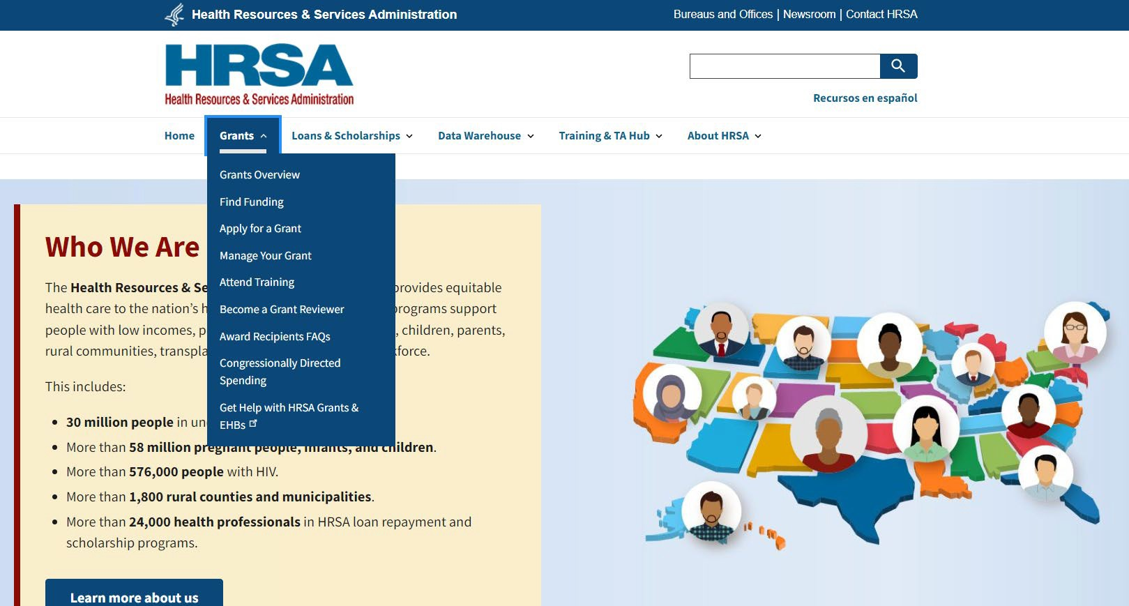
HRSA Funding Opportunities
https://www.hrsa.gov/grants/find-funding

Slide 11
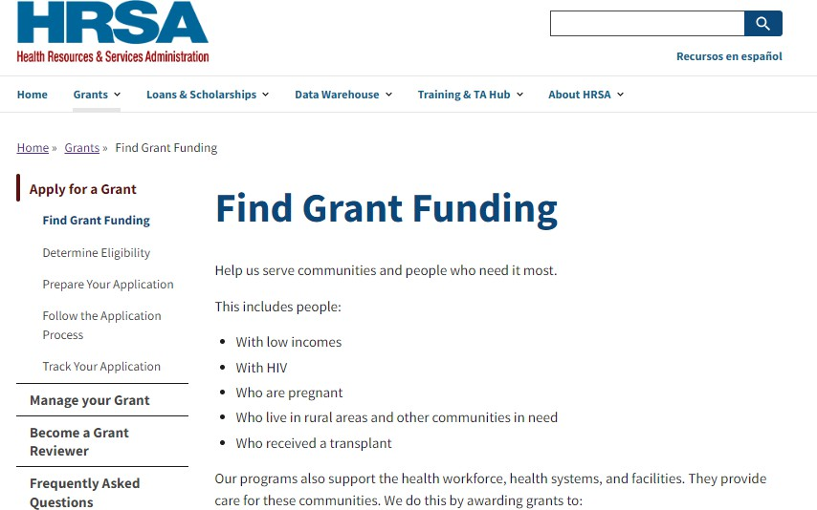
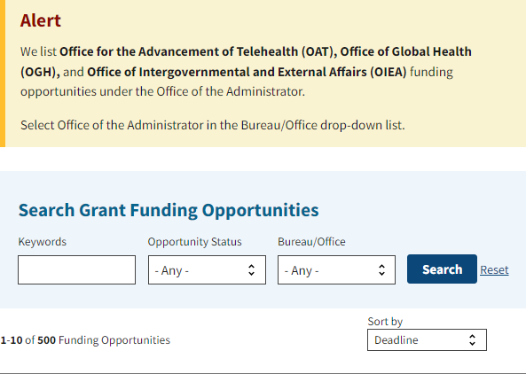
HRSA Funding Opportunities

Slide 12
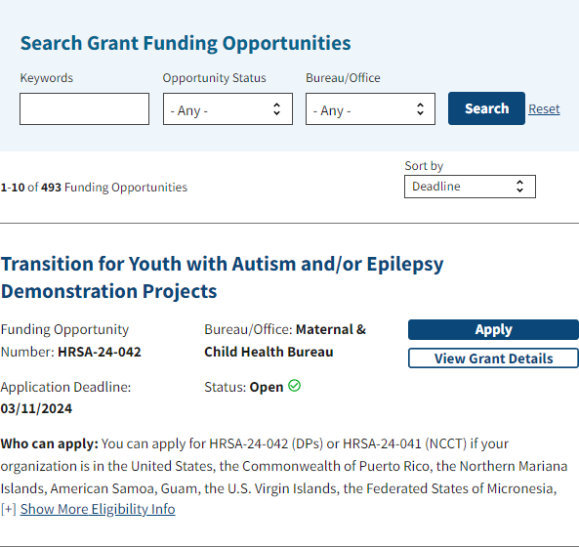
HRSA Funding Opportunities

Slide 14
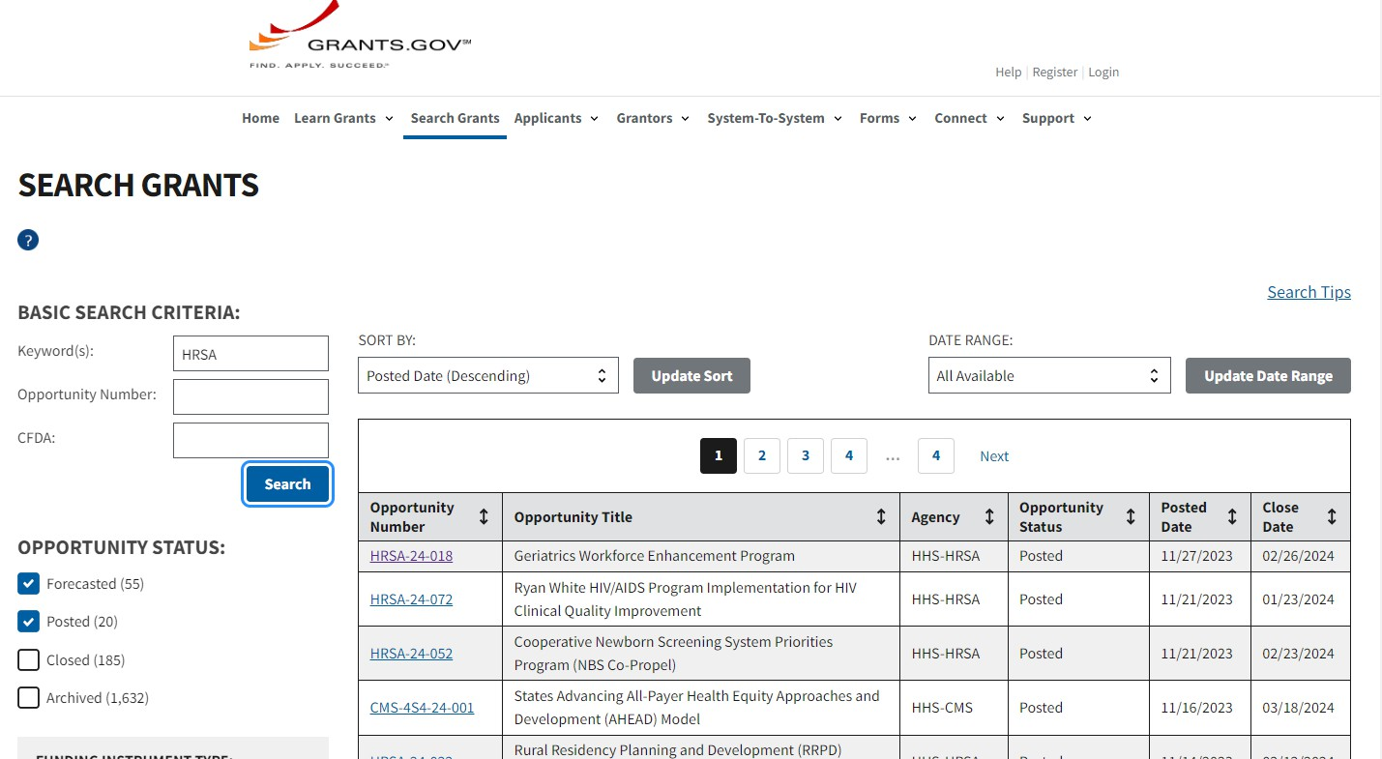

Slide 15
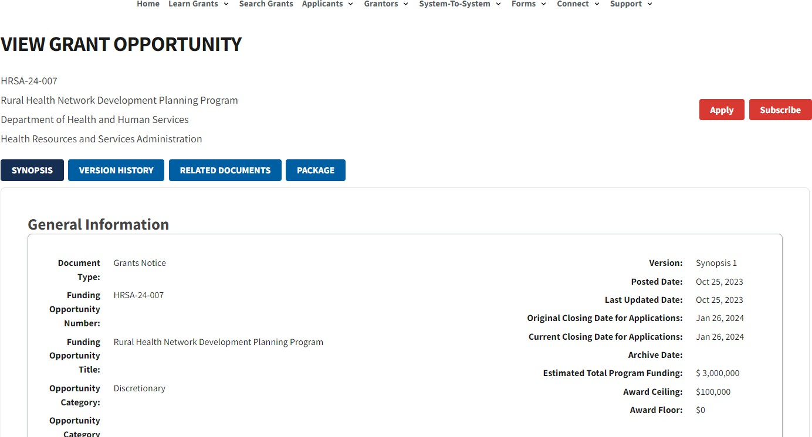

Slide 16
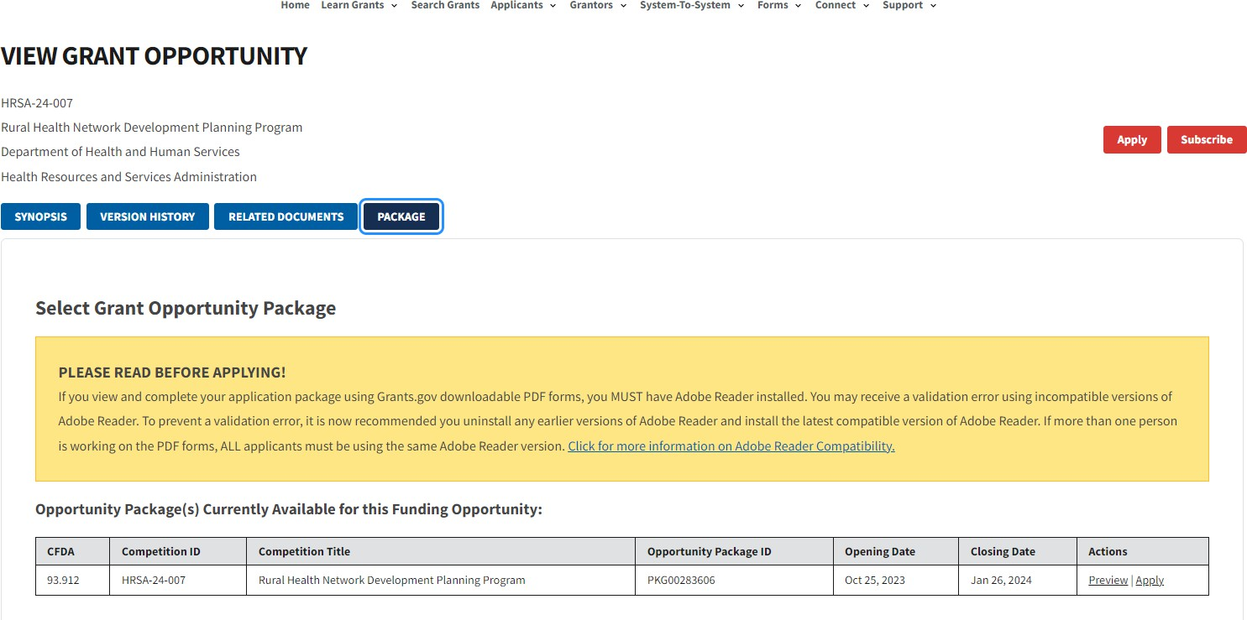

Slide 17
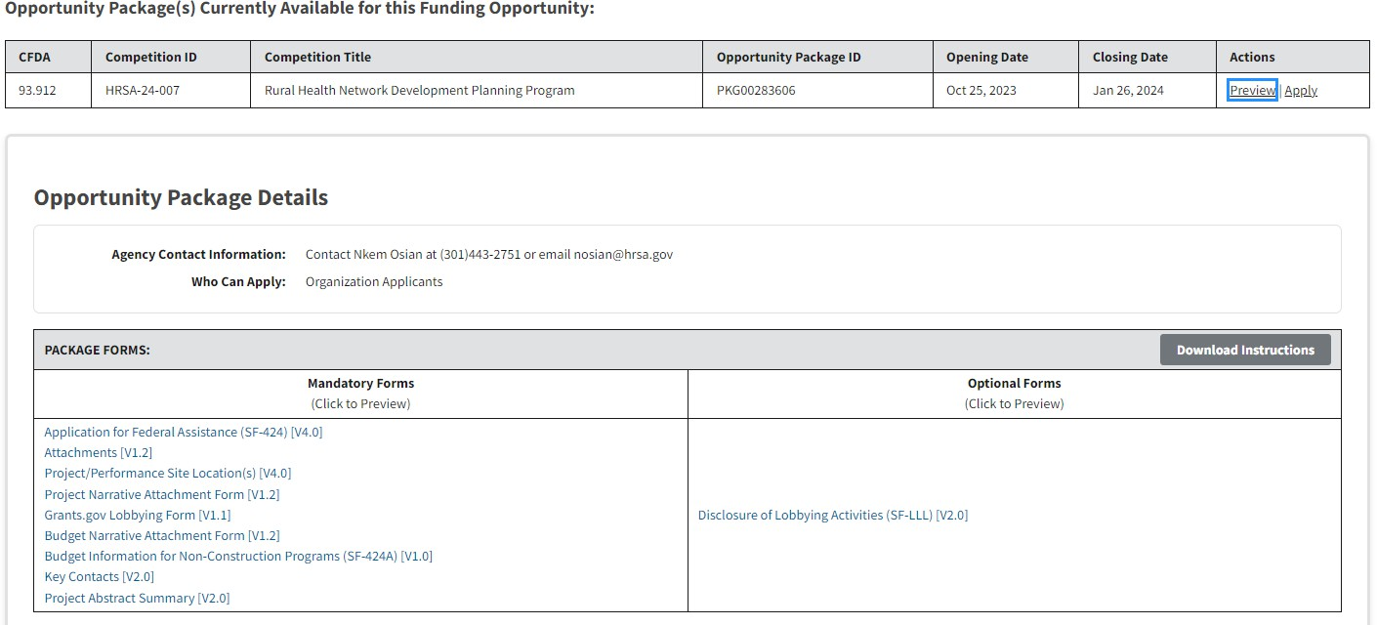

Slide 18
Grants.gov Support
Grants.gov Contact Center
24 hours a day, 7 days a week
Closed on federal holidays
Phone: 1-800-518-4726
Email: support@grants.gov
iPortal: Top 10 requested help topics (FAQs), Searchable knowledge base, self service ticketing and ticket status, and live web chat

Slide 19
Manage Grants.gov Subscriptions

Slide 20
Where to Find Notice of Funding Opportunities
Grants.gov: http://www.grants.gov
HRSA Website: http://www.hrsa.gov/grants
Register to get email notifications when opportunities are available on Grants.gov:
https://www.grants.gov/connect/manage- subscriptions/

Slide 21
The Federal Grant Application Process:
NOTICE OF FUNDING OPPORTUNITY (NOFO)

Slide 22
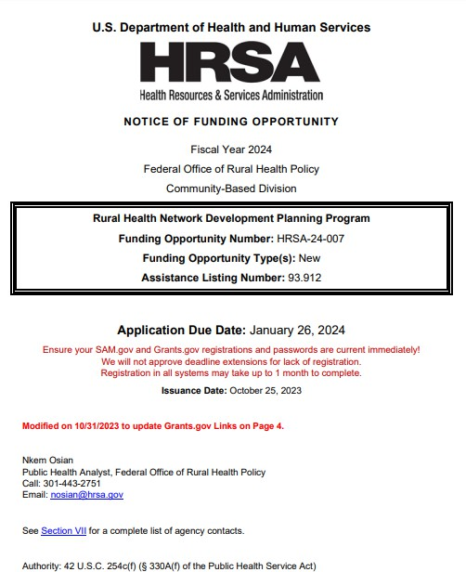
Notice of Funding Opportunity (NOFO)
Explains available funding, application, and eligibility information
Contains information applicants need to know to apply for funding
Includes program history, regulations, and contact information

Slide 23
What’s in A Notice of Funding Opportunity (NOFO)?
Section I: Program Funding Opportunity Description
Section II: Award Information
Section III: Eligibility Information
Section IV: Application and Submission Information
Section V: Application Review Information
Section VI: Award Administration Information
Section VII: Agency Contacts
Section VIII: Other Information
Section IX: Tips for Writing a Strong Application
Appendix: Budget

Slide 24
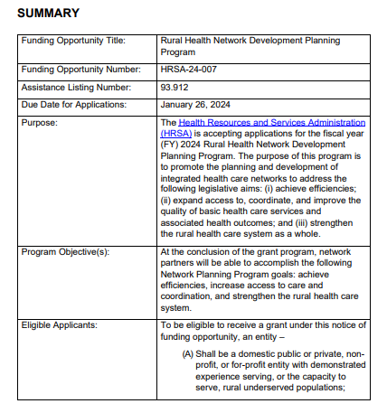
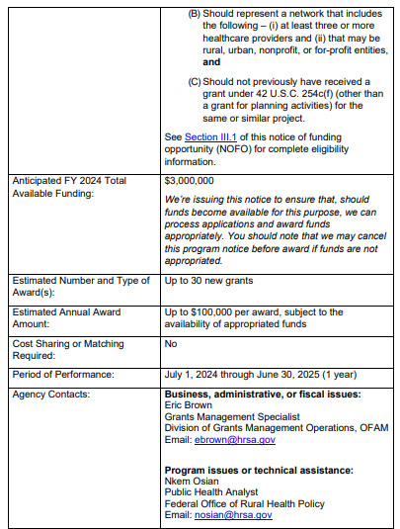
Executive Summary
Serves as a summary to potential applicants about the funding opportunity. It usually comprises the following:
Name of Program/Title
Synopsis of Purpose
Funding Opportunity Number
Due Dates
Available Funding
Number of Awards/Type of Award
Cost Sharing/Match Requirement
Project Period
Project Start Date
Eligible Applicants for Funding
Link to SF-424 Application Guide (See Glossary of Terms)

Slide 25
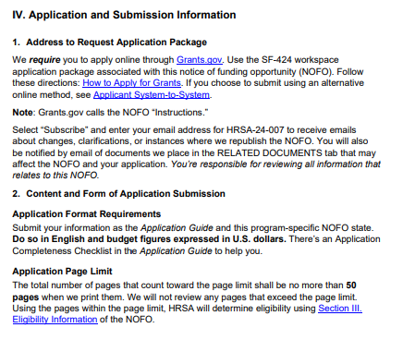
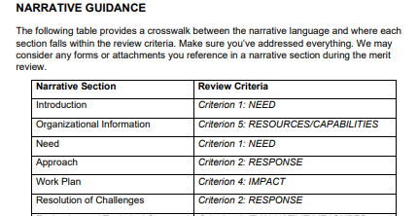
Application and Submission Information

Slide 26
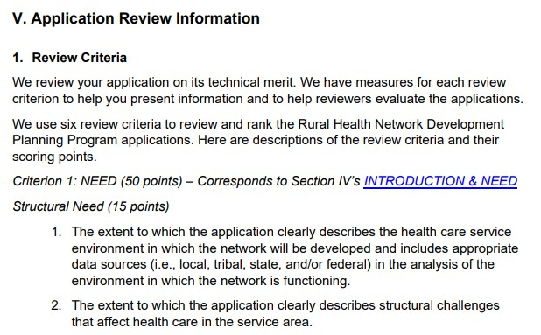
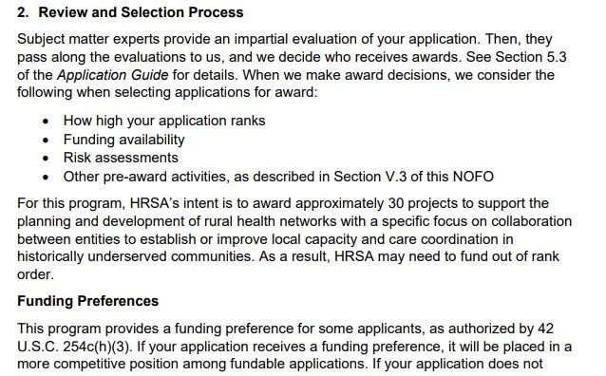
Application Review
Addresses the criteria that agency will use to evaluate applications.
Includes the merit and other review criteria that evaluators will use to judge applications, including any statutory, regulatory, or other preferences (e.g., minority status or Native American tribal preferences) that will be applied in the review process.

Slide 27
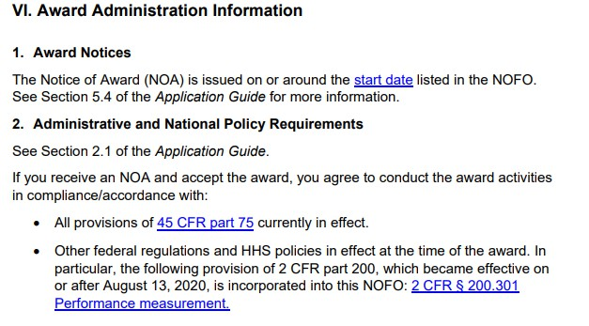
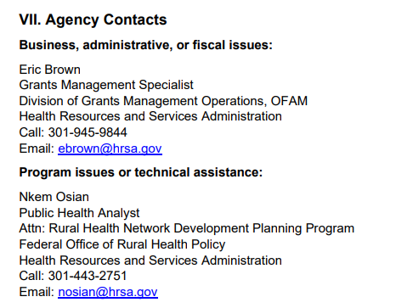
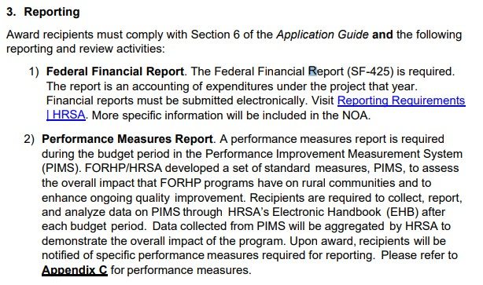
Award Administration and Agency Contacts

Slide 28
The HRSA Review Process
The central review office is the Division of Independent Review (DIR)
Applications are reviewed by an Objective Review Committee (ORC)
The ORC Panel is comprised of independent qualified Reviewers
ORC is responsible for evaluating and rating eligible applications in response to the NOFO

Slide 29
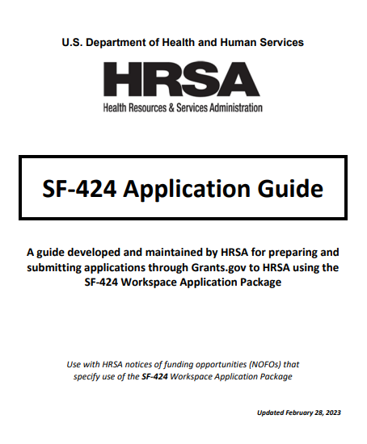
Application Guides
Notice of Funding Opportunity Companion Guide
Detailed instructions to help applicants prepare and submit applications
There may be different guides, please see the NOFO for which one to reference

Slide 30
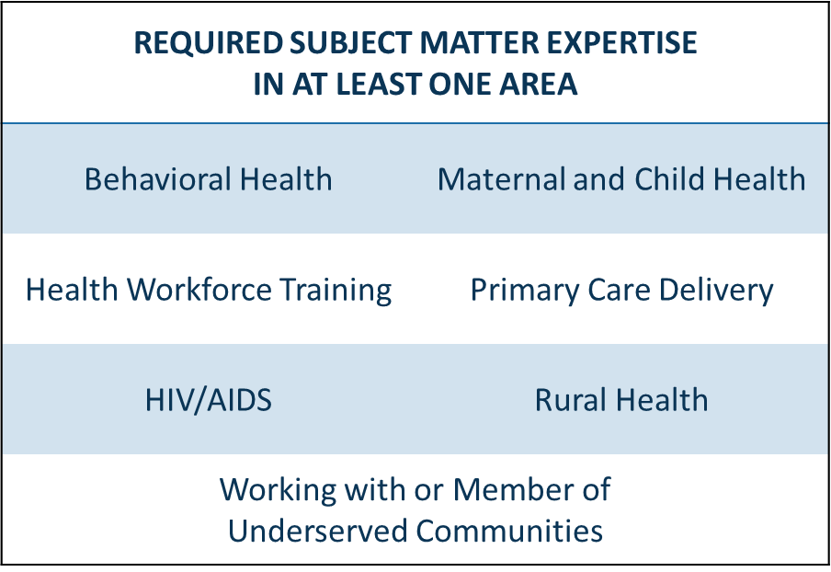
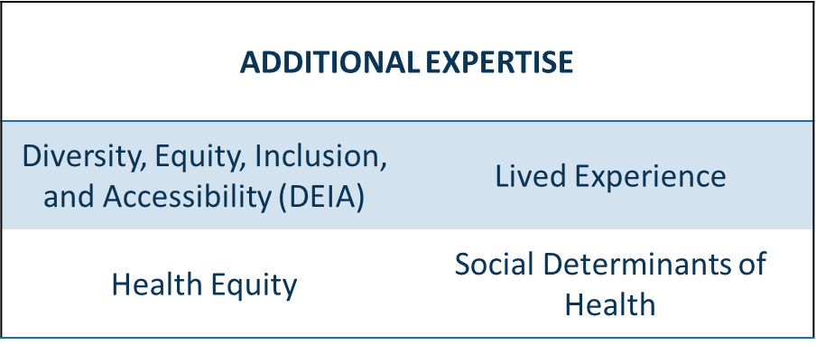
Become a HRSA Grant Reviewer
We are seeking subject matter experts to provide peer, virtual reviews of the agency’s grant applications.
Grant reviewers are compensated for their time.
If you are interested in serving as a grant reviewer, you can learn more at
hrsa.gov/grants/reviewers

Slide 31
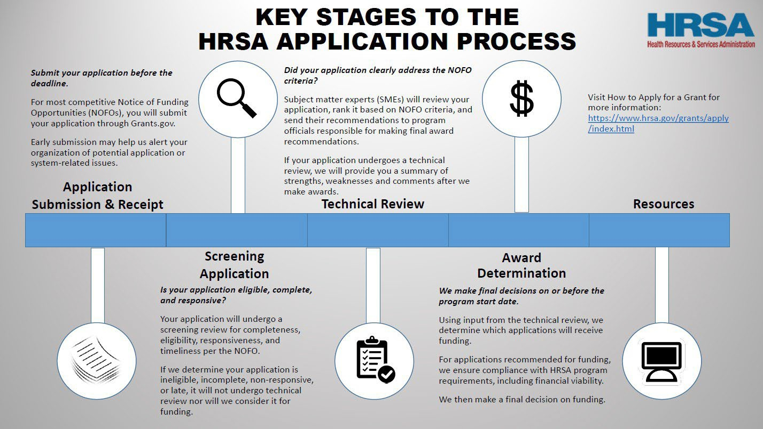

Slide 32
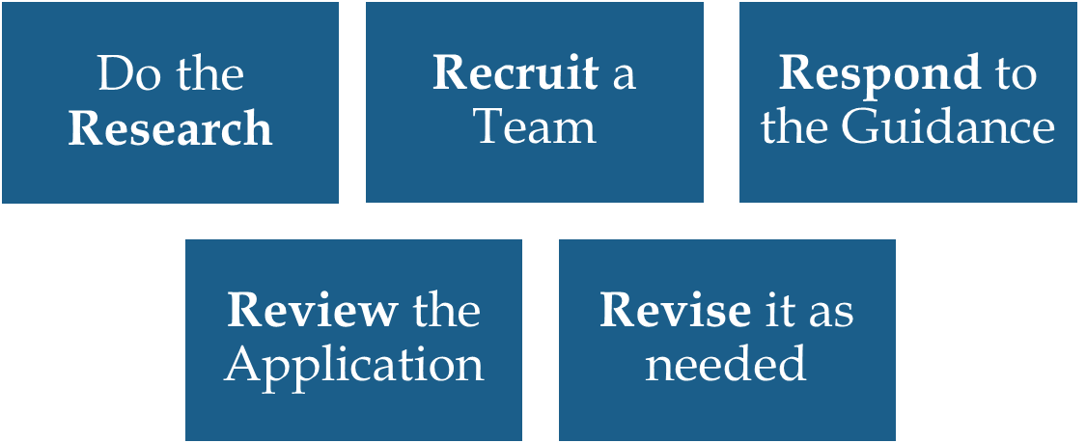
The Five “Rs”
Submitting Strong Applications

Slide 33
Do the Research
Learn about the grant program
Study projects that have been awarded in the past
Assess the specifics of the NOFO and how it relates to HHS’s overall missions and goals
Ensure you understand the application requirements
Consider your organization’s capacity (i.e., staffing, fiscal infrastructure, etc.)
Evaluate the time-cost benefit of applying for the funding opportunity
Do not ask yourself if the organization needs the funding, but rather whether the organization can commit to the potential project.

Slide 34
Recruit a Team
Internal Team
Help draft the application
Talk with colleagues and partners
Provide honest feedback
Have knowledge of the your organization
Consortium/Network Members
Determine the roles and participation levels
Obtain written commitments (i.e. MOUs)
Consider overall network structure

Slide 35
Respond to the Guidance
General Tips
Use clear and concise language and make it easy to read
Stay focused on the project activities
Avoid jargon and acronyms
Describe gaps in current services
Don’t assume reviewers’ knowledge of your area/program
Use current data sources

Slide 36
Review Your Application
Be willing to utilize all available resources to strengthen the application
Grant writers?
Advantages/Disadvantages
Other Resources

Slide 37
Write a Strong Application
Have I read the funding opportunity announcement?
Is my organization eligible to apply?
Does my organization have the technical expertise, the personnel, and the financial capacity?
Are all stakeholders in my organization supportive?
Is my organization prepared to do what it takes?

Slide 38
The Federal Grant Application Process:
COMMON MISTAKES IMPORTANT TIPS

Slide 39
Top Ten Tips for Applicants!
Start preparing the application early.
Time is needed to:
‐ Ensure registration
‐ Assemble team
‐ Review materials
‐ Outreach to funder
‐ Participate in Technical Assistance calls/webinars
‐ Respond to the NOFO
‐ Submit before the deadline

Slide 40
Top Ten Tips for Applicants!
Follow the instructions in the NOFO carefully.
All information should be placed in the order requested.
A careful and ordered response is key because it:
‐ Allows an applicant ease of review before submission; and
‐ Eliminates the possibility of Reviewers having to look for information or possibly overlooking information.
Keep your audience in mind.
Reviewers cannot include outside information and will review what is in your proposal.
Responses should speak to the program requirements.
Assume nothing, and keep the review criteria in mind.

Slide 41
Top Ten Tips for Applicants!
Be brief, concise, and clear.
Be organized and logical.
Applications that fail to project a complete and thorough thought process, run the risk of receiving low scores during the review process.
Completeness is key in thought as well as required attachments.

Slide 42
Top Ten Tips for Applicants!
Show evidence of fiscal stability and sound fiscal management.
Review your internal fiscal operations.
Do you have the capacity to handle federal funds?
Cite past experiences where and when possible.
Where does your organization sit financially after the project is completed?
What percentage of your annual operating revenue would be the potential award?

Slide 43
Top Ten Tips for Applicants!
Attend to technical details.
Top Grants.gov Failures:
‐ SAM.gov Expirations
‐ File Type Associations
Be careful in the use of attachments.
Do not use attachments for information required in the narrative.
Cross reference tables and attachments to the appropriate
section of the application.
Upload required forms in the proper order.

Slide 44
Top Ten Tips for Applicants!
Print out and carefully review your electronic applications for accuracy and completeness.
Submit all information at the same time.

Slide 45
Common Mistakes
Not registered with Grants.gov
Expired SAM registration
Application is rejected for errors and applicant did not leave enough time to correct before the deadline
Rejection email is in spam folder
AOR is not approved by E-Biz Point of Contact
AOR is not available to submit the application
Applying to the wrong announcement number
Application exceeds page limits

Slide 46
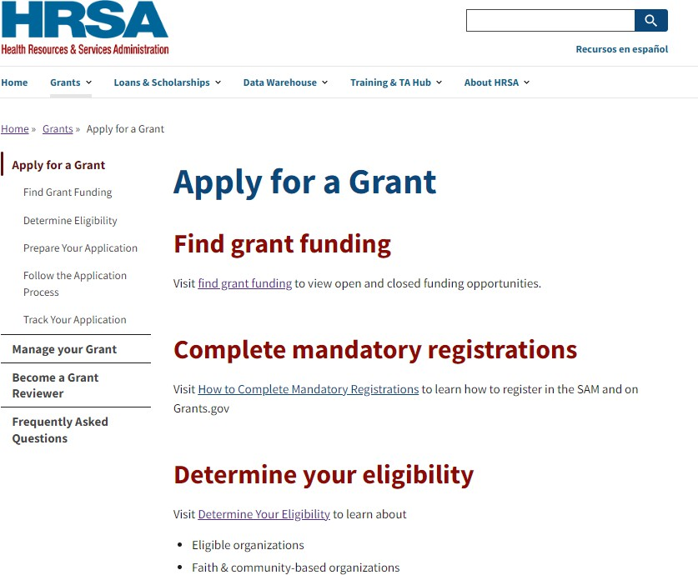
HRSA Grant Technical Assistance Resources
HRSA Grants Technical Assistance (TA) Webpage https://www.hrsa.gov/grants/apply-for-a-grant
One-stop-shop for potential applicants on how to apply for HRSA Federal assistance.
Applicants will find valuable information on how to apply for HRSA grants. The page includes technical assistance guidance and a wealth of other relevant and useful information and links tailored to HRSA- specific process and requirements.

Slide 47
HRSA Grant Technical Assistance Resources
http://data.hrsa.gov

Slide 48
HRSA
Contact Information
Name: Gabriele (Brie) Colangelo Title: Deputy Regional Administrator
HRSA Office of Intergovernmental and External Affairs in Region 9 (San Francisco)
Email: Gcolangelo@hrsa.gov

Slide 49
Connect with HRSA
Learn more about our agency at:
www.HRSA.gov
Sign up for the HRSA eNews
FOLLOW US:

